Slide 1
Linkers & Loaders –
A Programmers Perspective

Slide 2
Agenda..
Basic concepts
Object Files
Program Loading
Linking with static libraries
Linking with dynamic libraries

Slide 3
The Basics..
Compiler in Action…
  gcc foo.c bar.c –o a.out
foo.c
bar.c
run preprocessor (cpp) & compiler proper (cc1)
foo.s
bar.s
run assembler (as)
foo.o
bar.o
linker
a.out
a.out = fully linked executable

Slide 4
What is Linker ?
Combines multiple relocatable object files
Produces fully linked executable – directly loadable in memory
How?
  Symbol resolution – associating one symbol definition with each symbol reference
  Relocation – relocating different sections of input relocatable files

Slide 5
Object files..
Types –
  Relocatable : Requires linking to create executable
  Executable : Loaded directly into memory for execution
  Shared Objects : Linked dynamically, at run time or load time
Formats –
  a.out, IBM360, OMF, COFF, PE, ELF, ELF-64 …
  http://www.nondot.org/~sabre/os/articles/ExecutableFileFormats/

Slide 6
Object Files .. (Cntd)
ELF relocatable Object File
  .text – machine code
  .rodata – format strings in printf
  .data – initialized globals
  .bss – uninitialized globals
ELF HEADER
.text
.rodata
.data
.bss
.symtab
.rel.text
.rel.data
.debug
.line
.strtab

Slide 7
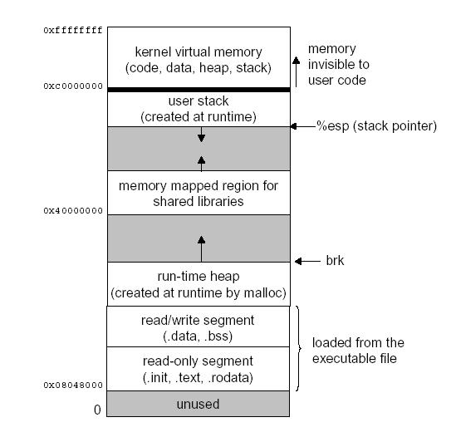
Program Loading
Linux run-time memory image
  on execve

Slide 8
Symbol Resolution..
3 types of symbols resolved during linking
  Non-static global symbols defined by object file
  Extern global symbols referenced by object file
  Static symbols local to object file/function
Local Automatic variables : managed on stack & not of interest to linkers

Slide 9
Symbol Resolution ..(Cntd)
Resolving Global Symbols –
  Strong Symbols : functions, initialized global variables
  Weak Symbols : uninitialized global variables
Rules of thumb –
  Multiple strong symbols – not allowed
  Given a strong and multiple weak symbols, choose the strong symbol
  Given multiple weak symbols, choose any weak symbol

Slide 10
Linking with Static Libraries
Collection of concatenated object files – stored on disk in a particular format – archive
An input to Linker
  Referenced object files copied to executable
bar.o
libm.a
foo.o
libc.a
printf.o & fopen.o
linker(ld)
fully linked executable object file
a.out

Slide 11
Resolving symbols using static libs.
Scans input relocatable files from left to right as on command line
  Maintains set E of object files req to form executable, set U of unresolved symbols, set D of symbols defined in prev files.
  Updates E, U and D while scanning input relocatable files
  U must be empty at the end – contents of E used to form executable
Problems ?
  Libraries must be placed at the end of command line.
  Cyclic dependency ??
  Size of the executable ???
  Change in library requires re-linking

Slide 12
Relocation – The heart of Linker
Relocating sections and symbol definitions
  Merges all sections of similar types
  Assigns unique run-time address to every instruction/var
Relocating symbol references within sections
  Modifies symbol references inside sections – make them point to correct run-time addresses
  Uses relocation entries for the above purpose
    Created for every un-defined reference
    Placed in .relo.text & .relo.data sections
    Contains offset, symbol & type (algorithm)
  Iterates over relocation entries and relocates

Slide 13
Dynamic Linking – Shared Libraries
Addresses disadvantages of static libraries
  Ensures one copy of text & data in memory
  Change in shared library does not require executable to be built again
  Loaded at run-time by dynamic linker, at arbitrary memory address, linked with programs in memory
  On loading, dynamic linker relocates text & data of shared object; also relocates any references in executable to symbols defined in shared object
  E.g. .so files in Linux/Sun; .sl in HPUX; DLLs in Microsoft Windows
  Can be loaded dynamically in the middle of execution – dlopen, dlsym, dlclose calls in Linux/Sun; shl_load, shl_findsym in HPUX, LoadLibrary, GetProcAddress in Windows

Slide 14
Shared Libraries ..(Cntd)
Linker creates libfoo.so (PIC) from a.o b.o
a.out – partially executable – dependency on libfoo.so
.interp section in a.out – invokes dynamic linker
Dynamic linker maps shared library into program’s address space
a.o
b.o
linker
-fPIC
bar.o
libfoo.so (position independent shared object)
linker
Partially linked executable – dependency on libfoo.so
a.out
loader (execve)
dynamic linker (ld-linux.so)
fully linked executable in memory

Slide 15
Position Independent Code (PIC)
Important property – required by shared libraries
  No absolute addresses – hence can be loaded and executed at any address
  Uses PC-relative/indirect addressing
Indirect addressing – required for externally defined functions and globals
  Uses Global Offset Table (GOT) to resolve unreferenced global variables
  Uses a Procedure Linkage Table (PLT) along with GOT to resolve unreferenced functions
  GOT resides at the start of data segment, GOT entries are fixed at run-time to point to correct run-time address
  Lazy binding of function calls

Slide 16
Thank You all !!

